Slide 1


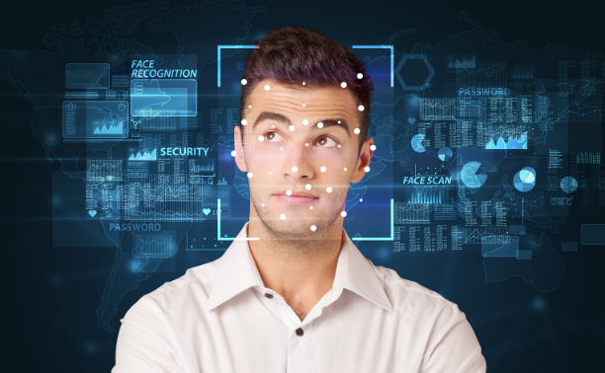
“Face Recognition Attendance System”
Guided by: Prof. Ritviz Singh, Prof. Shiv Patel
Symbiosis Skills and Professional University, Pune
1
Data Associate-03 Batch
2
Presented by:
Sep 2023 - Jan 2023
Mayur Borse
Vidya Lamkhade
Saurabh Pardeshi
Jayesh Erande

Slide 2
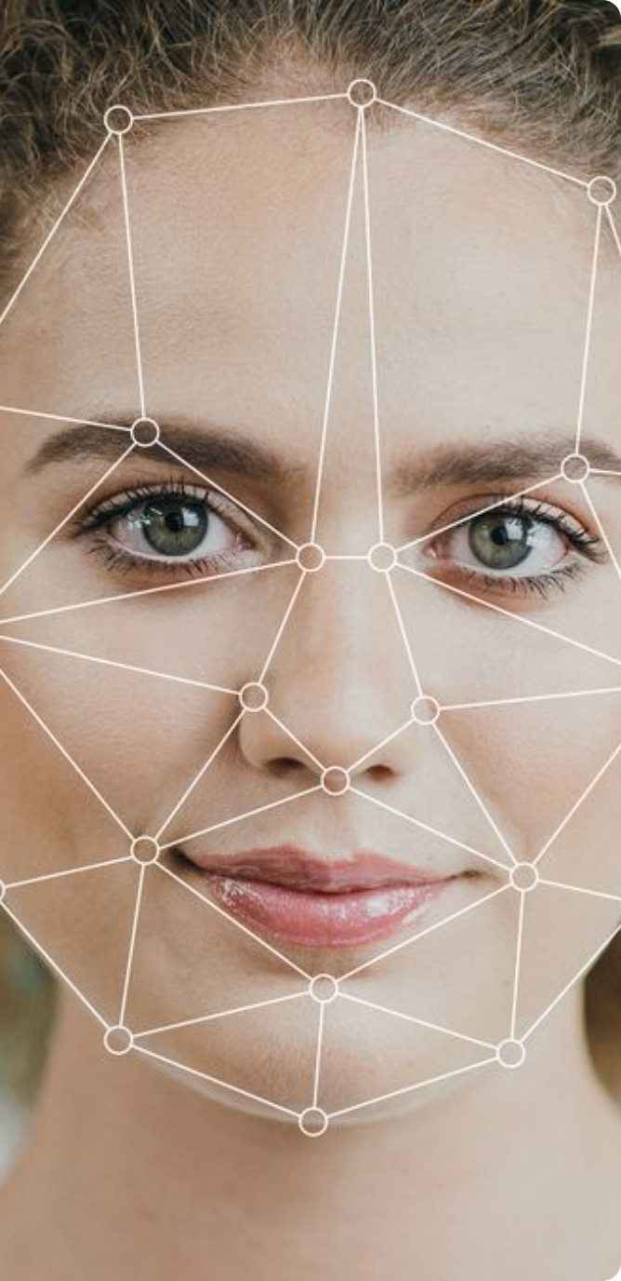
Face Recognition and Attendance System
ABSTRACT
INTRODUCTION
PROBLEM STATEMENT
ALGORITHM
SYSTEM ARCHITECTURE
FUTURE SCOPE
SCRRENSHOTS
CONCLUSION

Slide 3

Introduction
The system's goal is to make the attendance marking process quick and easy because the teacher's in class is time consuming in monitoring the students while marking attendance and ensuring that no proxy attendance is marked.
To solve the problem efficiently, the system employs a machine approach that makes use of Python's OpenCV library.
The Haarcascade algorithm and the LBPH algorithm are used for face detection and recognition.
The system is designed to be sufficiently accurate in comparison to other systems.

Slide 4

Problem Statement
Time Consuming 🕐
Paper Saving 🤖
Traditional systems take more time to register the attendance of each employee which can lead to unproductiveness.
Save a lack of papers and this is great full
For the environment.
Security Risk 🔓
Paper list and cards used in traditional attendance systems pose security risks for sensitive company data.

Slide 5

Algorithm
1)HaarCascade Algorithm:-
The HaarCascade algorithm requires a trained classifier to detect faces. Training involves providing the algorithm with positive samples (images containing faces) and negative samples (images without faces).
The algorithm learns to identify features that are characteristic of faces during this training phase.
2)LBPH Algorithm:-
The Local Binary Pattern Histogram (LBPH) algorithm is a texture-based method commonly used for facial feature extraction and recognition in computer vision applications.
Convert the input image to grayscale, as LBPH operates on intensity information.
Divide the image into a grid of cells. For each pixel in a cell, compare its intensity value with the intensities of its neighbors in a circular neighborhood. Assign a binary code (0 or 1) to each neighbor based on whether its intensity is greater or less than the central pixel's intensity.
Concatenate these binary codes to form an LBP pattern for each pixel in the cell.
.

Slide 6
System Architecture

Slide 7

Future Scope
1
Auto-scheduling
2
Smart Security
Automatically generate employee schedules based on attendance data to optimize operations.
Integrating with security cameras to improve security and identify suspicious activity.
3
Synchronized HR data
Integrating HR data such as leaves and employee performance for comprehensive analysis.

Slide 8
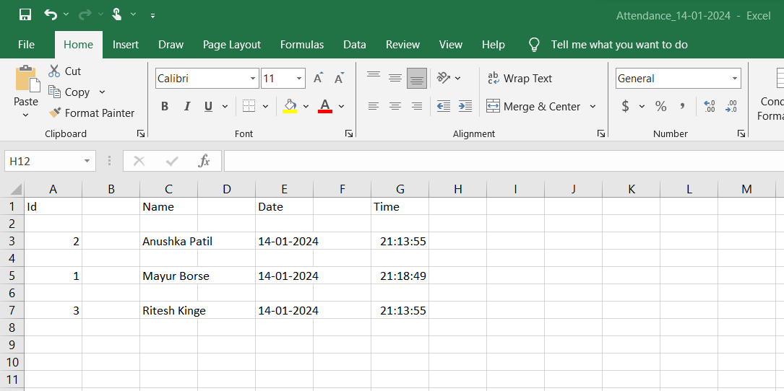

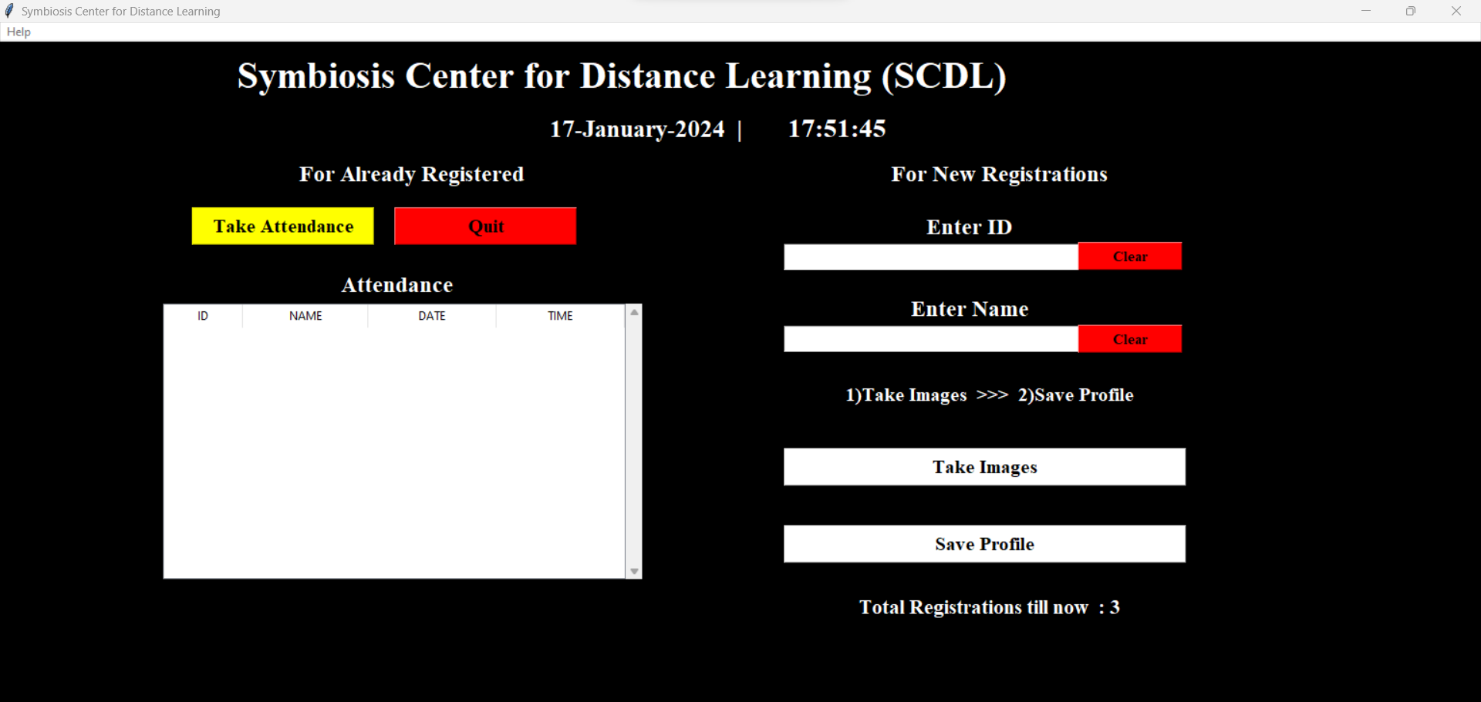
Screenshots
Attendance Dashboard
Home Page
Student Detail
View attendance data across the organization in real-time
User Friendly interface by tkinter
Detail Store In CSV file

Slide 9

Conclusion
In conclusion, the implementation of a face recognition attendance system offers a range of benefits and advancements in attendance tracking for various sectors. The utilization of facial recognition technology brings efficiency, accuracy, and convenience to the attendance management process. Through the analysis of facial features, the system can uniquely identify individuals, providing a reliable and secure means of recording attendance

Slide 10

Thank You
Thank you for attending this presentation. We welcome any feedback or questions you may have.

